Slide 1
Regularization and Model Tuning
Week 5
Mohammad Esmalifalak

Slide 2
Model fitting issues
One of the goals of machine learning is generalizability.
If your model works only on your training data, the model is effectively useless.
Depending on the training process your model might be
Underfitted
Overfitted
Well fitted

Slide 3
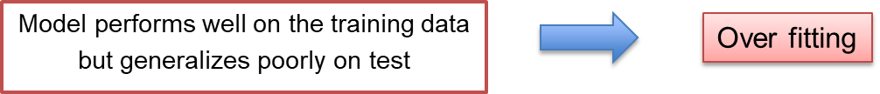
Over Fitting vs Under Fitting
X2
x
o
o
X2
x
o
o
X2
o
o
o
o
x
o
x
o
o
o
x
o
o
o
x
o
x
x
o
o
x
o
x
o
o
x
o
x
o
x
x
o
o
x
x
o
o
x
o
o
o
o
o
o
o
x
o
x
o
x
x
x
o
x
x
x
o
x
o
x
o
x
x
o
x
x
x
x
x
x
x
x
x
o
x
x
x
x
X1
X1
X1

Slide 4
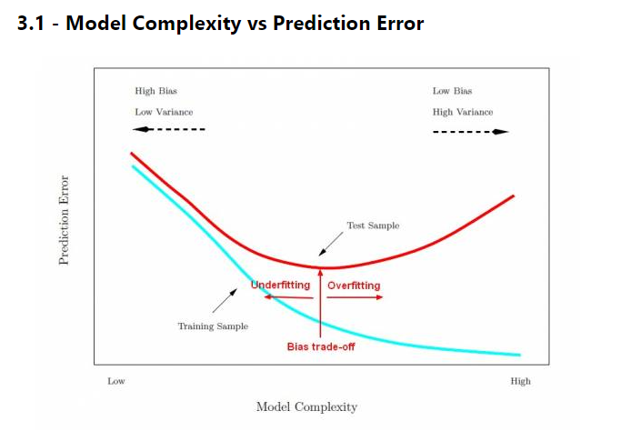
Overfitting vs Underfitting
Over-fitting
Generally occurs when a model is excessively complex.
Sensitive to noise and other parameters which were not modeled during the training.
Occurs when a model is over simplified
Number of training samples are not enough
Under-fitting

Slide 5
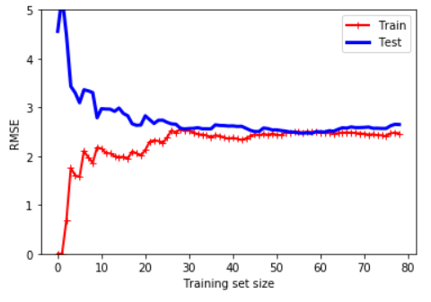
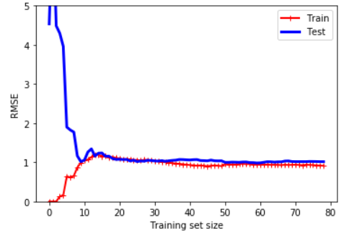
Over Fitting vs Under Fitting
1- Low training RMSE and high testing RMS at beginning
2- Training data goes up until it reaches a plateau
3- Both curves have reached a plateau; they are close
and fairly high (sign of under-fitting).
4- If model is under-fitting, adding more training data will
not help.
1- Low training RMSE and high testing RMS at beginning
2- Training data goes up until it reaches a plateau
3- Both curves have reached a plateau; they are close
and fairly low (sign of fitting right).

Slide 6
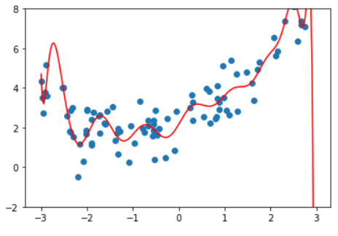
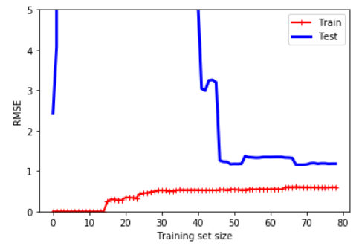
Over Fitting vs Under Fitting
Higher complexity = better fit to training data
(But less generalizable)
Low training RMSE but high testing RMS
at steady state (sign of over-fitting).
One way to improve an overfitting model is to feed it more training data until the validation error reaches the training error.

Slide 7
How to avoid overfitting?
Have a very large training data
Reduce model complexity
Regularization

Slide 8
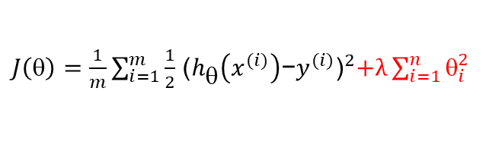
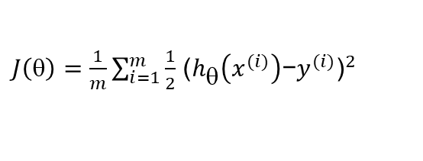
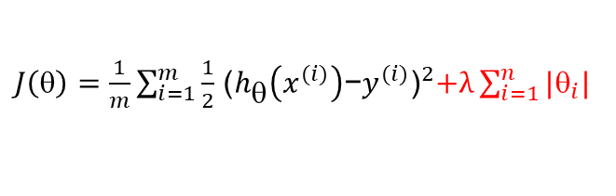
Regularization
Regularization (in General)
$J\left(θ\right)=\frac{1}{m}\sum_{i=1}^{m}{\frac{1}{2}}$ ${\text{(}h_{θ}\left(x^{(i)}\right)\text{−}y^{(i)}\text{)}}^{2}$
penalty='l2'
$J\left(θ\right)=\frac{1}{m}\sum_{i=1}^{m}{\frac{1}{2}}$ ${\text{(}h_{θ}\left(x^{(i)}\right)\text{−}y^{(i)}\text{)}}^{2}+λ\sum_{i=1}^{n}{θ_{i}^{2}}$
penalty='l1'
$J\left(θ\right)=\frac{1}{m}\sum_{i=1}^{m}{\frac{1}{2}}$ ${\text{(}h_{θ}\left(x^{(i)}\right)\text{−}y^{(i)}\text{)}}^{2}+λ\sum_{i=1}^{n}{|θ_{i}|}$

Slide 9

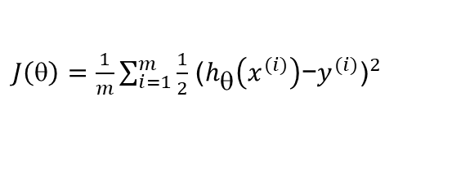
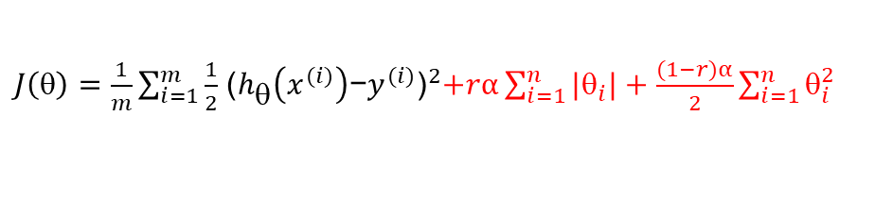
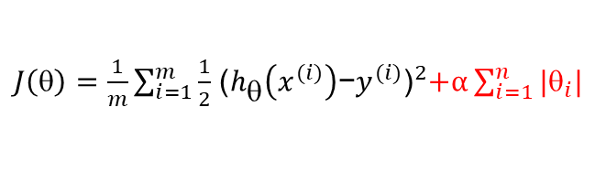
Regularization
Regularization (in linear regression)
$J\left(θ\right)=\frac{1}{m}\sum_{i=1}^{m}{\frac{1}{2}}$ ${\text{(}h_{θ}\left(x^{(i)}\right)\text{−}y^{(i)}\text{)}}^{2}$
Ridge Regression
$J\left(θ\right)=\frac{1}{m}\sum_{i=1}^{m}{\frac{1}{2}}$ ${\text{(}h_{θ}\left(x^{(i)}\right)\text{−}y^{(i)}\text{)}}^{2}+\frac{α}{2}\sum_{i=1}^{n}{θ_{i}^{2}}$
Lasso
Regression
$J\left(θ\right)=\frac{1}{m}\sum_{i=1}^{m}{\frac{1}{2}}$ ${\text{(}h_{θ}\left(x^{(i)}\right)\text{−}y^{(i)}\text{)}}^{2}+α\sum_{i=1}^{n}{|θ_{i}|}$
Elastic Net
$J\left(θ\right)=\frac{1}{m}\sum_{i=1}^{m}{\frac{1}{2}}$ ${\text{(}h_{θ}\left(x^{(i)}\right)\text{−}y^{(i)}\text{)}}^{2}+rα\sum_{i=1}^{n}{|θ_{i}|+\frac{(1−r)α}{2}\sum_{i=1}^{n}{θ_{i}^{2}}}$

Slide 10
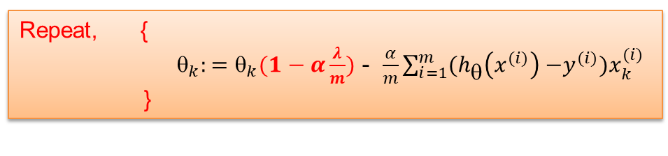
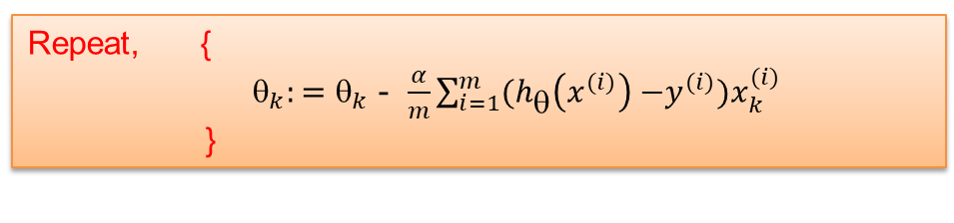
Regularization
Gradient Descent
Repeat, {
$_{k}:=_{k}$ - $\frac{α}{m}\sum_{i=1}^{m}{{(h}_{θ}\left(x^{(i)}\right){ −y}^{(i)})x_{k}^{(i)}}$
}
No Regularization:
Repeat, {
$_{k}:=θ_{k}(1−α\frac{λ}{m})$ - $\frac{α}{m}\sum_{i=1}^{m}{{(h}_{θ}\left(x^{(i)}\right){ −y}^{(i)})x_{k}^{(i)}}$ }
With Regularization:

Slide 11
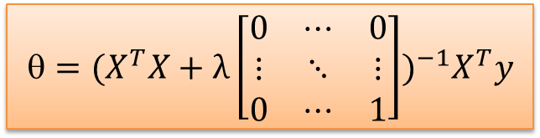


Regularization
Linear Regression
No Regularization:
$$={(X^{T}X)}^{−1}X^{T}y$$
$$={(X^{T}X+λ\left[\begin{matrix}0 & ⋯ & 0 \\ ⋮ & ⋱ & ⋮ \\ 0 & ⋯ & 1\end{matrix}\right])}^{−1}X^{T}y$$
With Regularization:
(Ridge Regression)
$$1$$

Slide 12
Feature Normalization
x1= size of house: (1000-3000)
x2= # of bedrooms: (0-5)
x1= (x1-mean)/range: [-0.5,0.5]
x2= # (x1-mean)/range: [-0.5,0.5]
$${^{T}X=}_{0}+_{1}x_{1}{+}_{2}x_{2}$$
$$_{2}$$
$$_{2}$$
Contours of $J\left(θ\right)$
$$_{1}$$
$$_{1}$$
Converging to global minimum is harder
Converging to global minimum is easier
Notes:
Crime rate: Per Capita

